Slide 1
Asma Banu.A
Final Project
3/21/2024 Annual Review

Slide 2
PROJECT TITLE
Handwritten Digital Signature
3/21/2024 Annual Review

Slide 3


AGENDA
Problem statement
Project overview
Who are the end user?
Your solution and its value Proposition
The wow in your solution
Modelling
Results
3/21/2024 Annual Review

Slide 4

PROBLEM STATEMENT
Develop an AI system to authenticate handwritten digital signatures, ensuring accuracy, robustness, and efficiency for secure digital transactions.
3/21/2024 Annual Review

Slide 5

PROJECT OVERVIEW
This project aims to develop an AI-based system for authenticating handwritten digital signatures, leveraging machine learning techniques to ensure secure and reliable verification in digital transactions and document authentication. The system will involve data collection, preprocessing, feature extraction, model training, and deployment phases to achieve high accuracy and efficiency in signature verification.
3/21/2024 Annual Review

Slide 6

WHO ARE THE END USERS?
Financial institutions: Banks, insurance companies, and other financial organizations often use digital signature detection for verifying signatures on documents such as loan agreements, contracts, and financial transactions.
Legal firms: Law firms and legal departments within companies may use digital signature detection for verifying signatures on legal documents, contracts, and agreements. 3.Government agencies: Government organizations may utilize digital signature detection for authenticating signatures on various official documents, including permits, licenses, and legal forms.
3/21/2024 Annual Review

Slide 7

YOUR SOLUTION AND ITS VALUE PROPOSITION
Value Proposition:
1. Legality and Compliance: Handwritten digital signatures often comply with legal requirements for electronic signatures, making them legally binding in many jurisdictions 2.Cost and Time Savings: By reducing the need for printing, mailing, and storing physical documents, handwritten digital signatures can save businesses time and money.
Solution:
Mobile Apps: Develop a mobile application that allows users to capture their handwritten signature using their smartphone or tablet touchscreens. The app should provide tools for users to customize their signatures and ensure clarity and consistency.
3/21/2024 Annual Review

Slide 8

THE WOW IN YOUR SOLUTION
Augmented Reality Signature Capture: Utilize augmented reality (AR) technology to create an immersive experience where users can physically write their signature in the air using a device's camera. The signature is then captured and
integrated into the document digitally, providing a futuristic and engaging signing experience.
Handwriting Recognition AI: Implement advanced artificial intelligence (AI) algorithms for handwriting recognition that can accurately interpret and convert handwritten signatures into digital format. This AI-driven solution ensures high accuracy and reduces the need for manual adjustments or corrections.
3/21/2024 Annual Review

Slide 9
MODELLING
Signature Verification:
Verify the authenticity of the captured signature to prevent fraud or unauthorized access.
Document Integration:
Integrate the signature functionality seamlessly into document management systems.
Encryption and Security:
Ensure that the digital signatures are encrypted and secure to protect against unauthorized access or tampering.
Compliance and Legal Support:
Ensure that the signature solution complies with relevant electronic signature regulations and standards.
3/21/2024 Annual Review

Slide 10
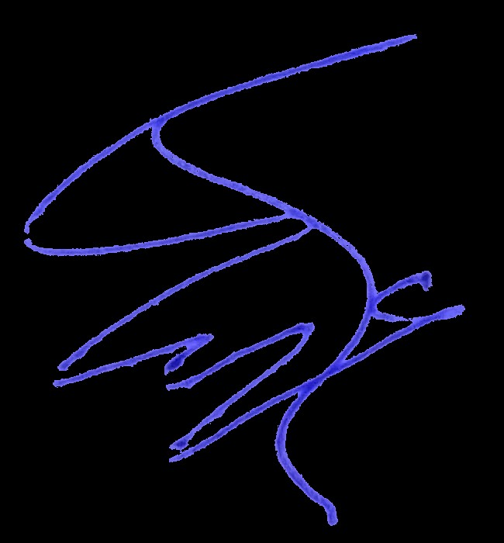
RESULTS
However, if the original image contained artifacts such as shadows or other markings on
the paper, then cropping them out can be helpful prior to creating the alpha mask.
Removing excess whitespace around the signature also makes it more convenient to work
with and transform once brought into a PDF editor.
Demo Link
3/21/2024 Annual Review

Slide 11


